Slide 1
NARRATIVE POINT OF VIEW
BRIDGE VALLEY ELEMENTARY

Slide 2
LESSON OBJECTIVE:
Identify the narrator of a story; identify the difference between first-person and third-person narrative point of view

Slide 3
I was sitting next to Kelly on the bus. Suddenly, I saw a kitten peek out of her backpack.
Tony was sitting next to Kelly on the bus. Suddenly, he saw a kitten peek out of her backpack.

Slide 4
FIRST-PERSON POV

Slide 5
THIRD-PERSON POV

Slide 6
BRAIN POP
https://www.brainpop.com/english/writing/pointofview/

Slide 7
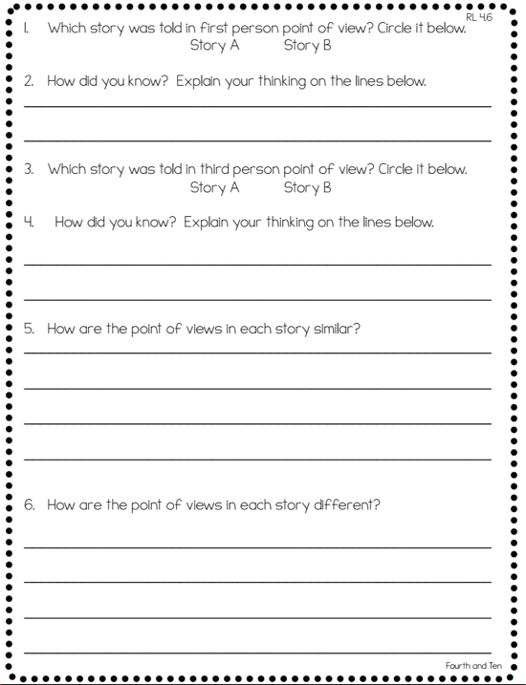
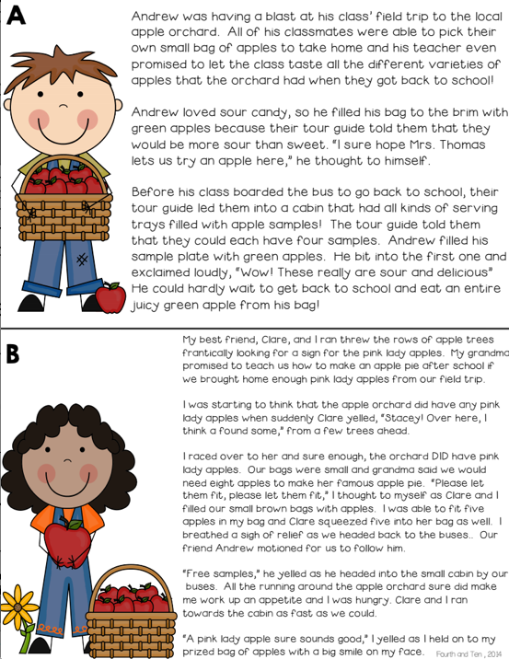
INDEPENDENT PRACTICE
Read through each task card with an adult
Complete the worksheet
Upload a picture of this worksheet to your SeeSaw account by taking a picture

Slide 8
NARRATIVE POINT OF VIEW
DAY 2

Slide 9
LESSON OBJECTIVE:
Identify the narrator of a story; identify the difference between first-person and third-person narrative point of view

Slide 10
TAKING A CLOSER LOOK…

Slide 11
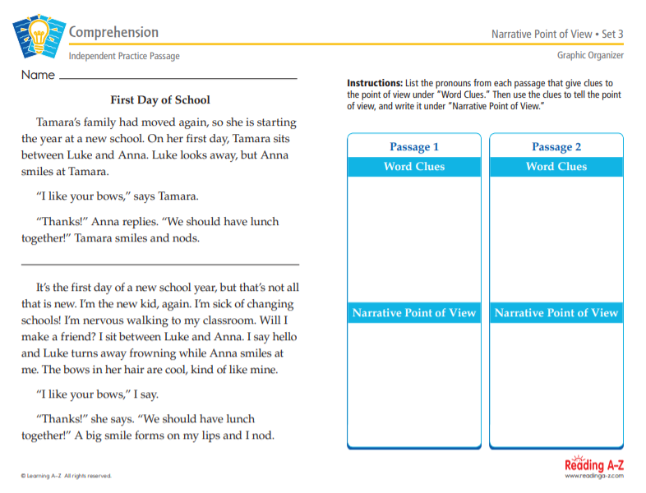
INDEPENDENT PRACTICE
Locate the passage labeled First Day of School
Complete the worksheet by using “word clues”
Upload a picture of this worksheet to your SeeSaw account

Slide 12
NARRATIVE POINT OF VIEW
DAY 3

Slide 13
LESSON OBJECTIVE:
Identify the narrator of a story; identify the difference between first-person and third-person narrative point of view

Slide 14
ANOTHER LOOK AT POV
https://www.youtube.com/watch?v=l3S_NI6kRv8

Slide 15
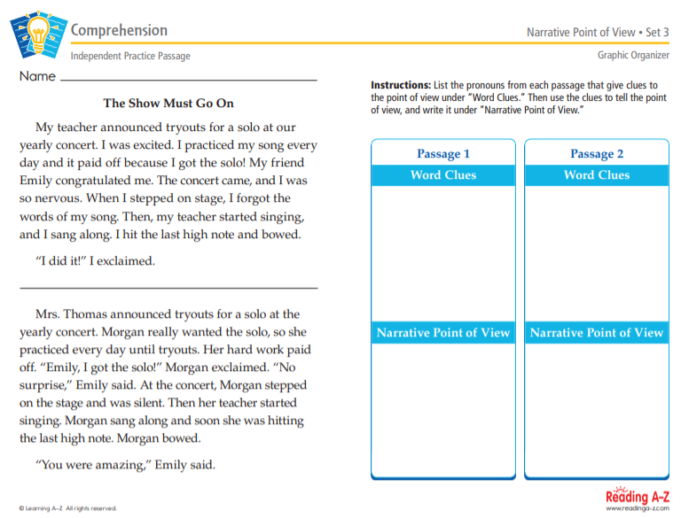
INDEPENDENT PRACTICE
Locate the passage provided by your teacher
Complete the worksheet by using “word clues”
Upload a picture of this worksheet to your SeeSaw account

Slide 16
NARRATIVE POINT OF VIEW
DAY 4

Slide 17
LESSON OBJECTIVE:
Identify the narrator of a story; identify the difference between first-person and third-person narrative point of view

Slide 18
REVIEW

Slide 19
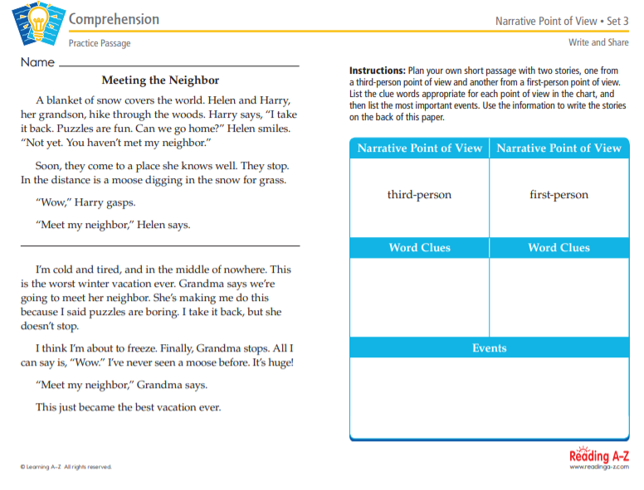
INDEPENDENT PRACTICE
Locate the passage and/or the text provided by your teacher
Read and complete the worksheet provided
Upload a picture of this worksheet to your SeeSaw account

